Slide 1

Engaging learning for early Childhood Professionals – Edmonton
March 7, 2011

Slide 2
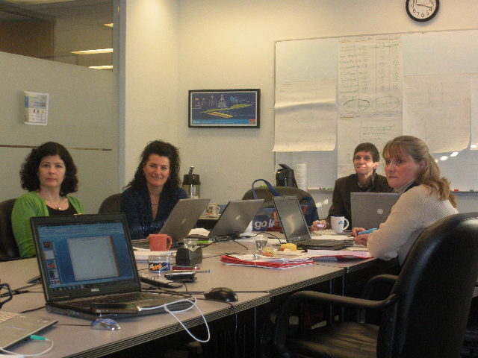

Slide 3

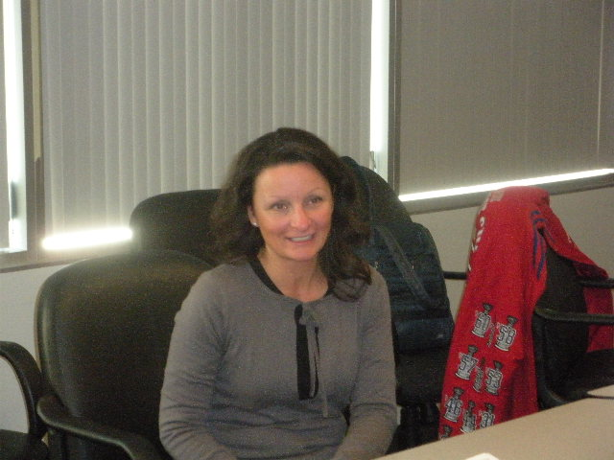
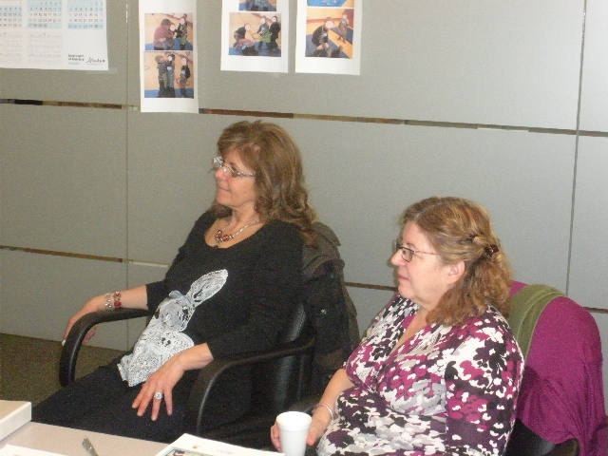


Slide 4
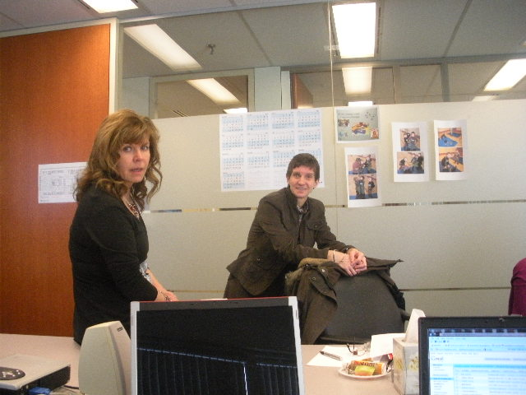

Slide 5

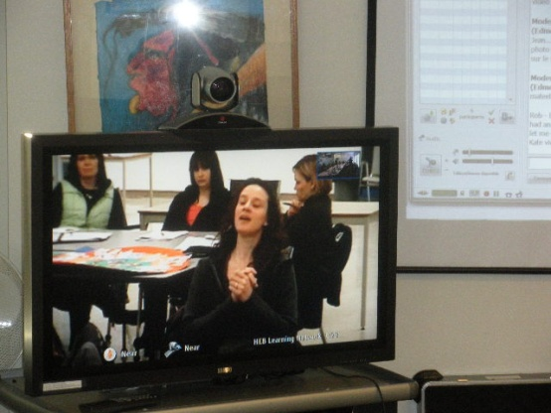
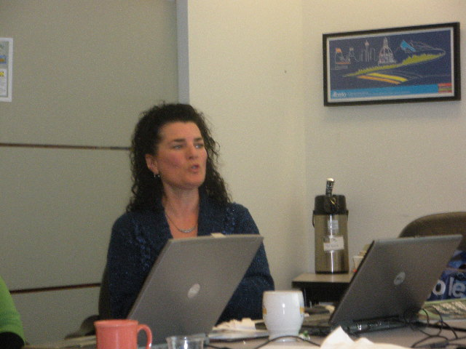

Slide 6
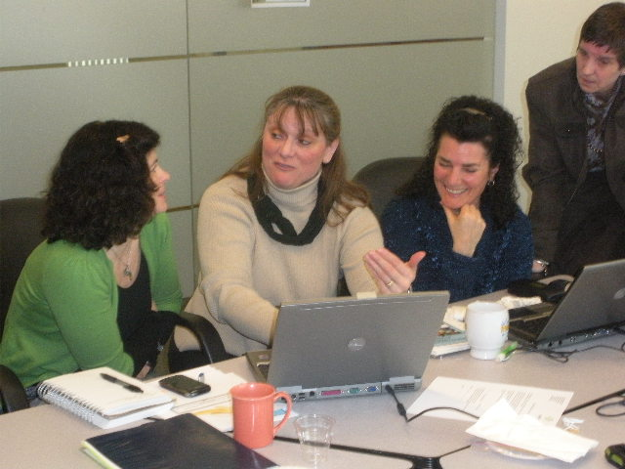

Slide 7
Merci!
Monique Marie-Josée
Lucie Annie
Josée Patricia
Francine

