Slide 1
How to relate to text
Personal Responses

Slide 2
You will be asked to …
Discuss ideas and impressions from the text(s) that are meaningful to you
Write in a prose form
Choose a perspective
Create a strong unifying effect

Slide 3
Choosing a Prose Form
Remember that a prose form is essentially anything except poetry
Must be able to assess the rules of formal writing
Short story
Short essay
Diary entry(ies)
Blog entry(ies)
Reminiscence
Newspaper article
Editorial
Internal monologue
Personal observation
Letter eulogy
Interview
Screen play
Speech
Anecdote
Commentary

Slide 4
Choosing a Perspective
Perspective is literally from whose perspective will the writing be written.
Personal
Creative
Critical

Slide 5
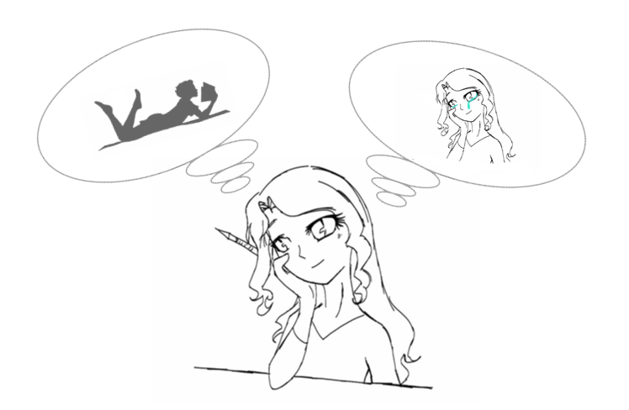
Personal

Slide 6
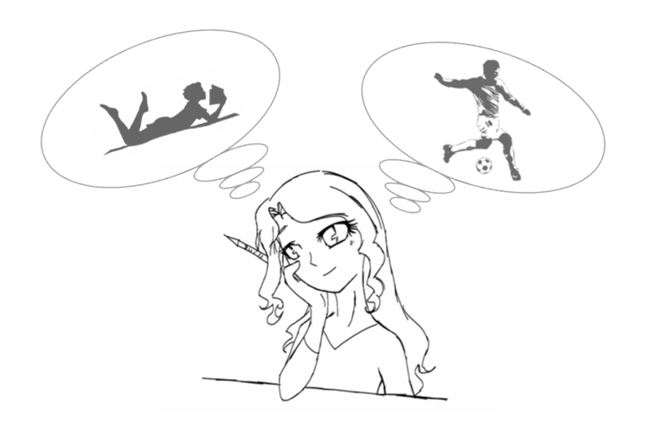
Creative

Slide 7
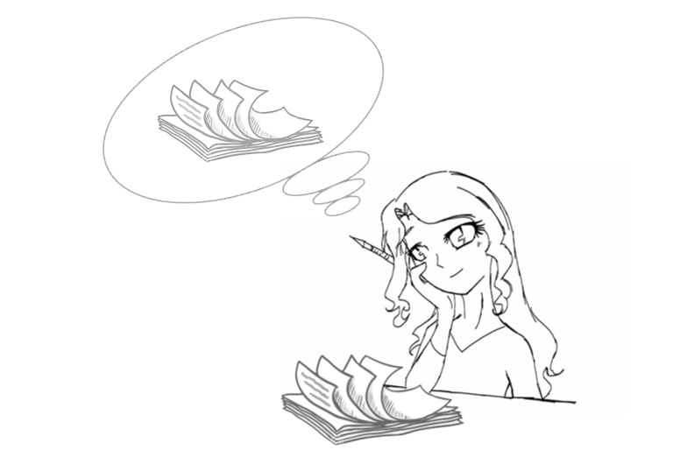
Critical

Slide 8
Steps for Writing
Theme from the text
Ideas, impressions, experiences, opinions, …
Supporting ideas
Details from the text to flesh out your theme
Prose Form
The type of writing that best fits your ideas
Perspective
How you approach the writing
Unifying idea
What you will use to weave your theme through the writing

